Slide 1


Software Engineering and Project Management-18CSC206J
Darsan RA
Karthik S
Divyesh B

Slide 2
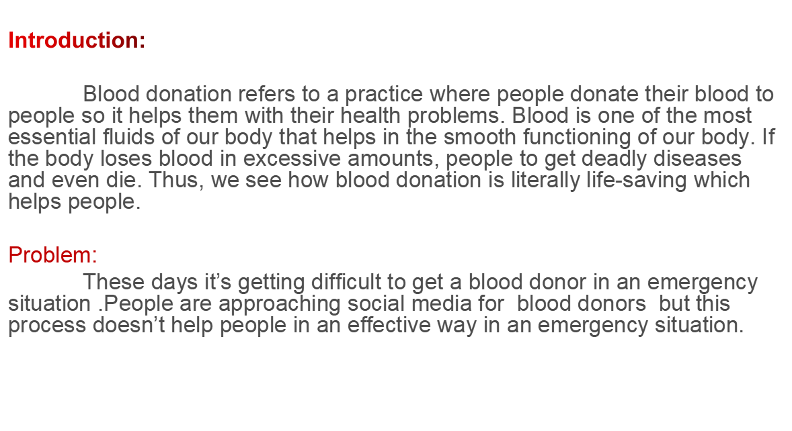
PROBLEM STATEMENT

Slide 3
Proposal
This problem can be solved by making an application which connects hospitals,blood banks and blood donors.In this application,different hospitals and blood banks of a city creates a message alert to the registered users (who are willing to donate blood) .This alert consists a message that a patient in respective hospital needs a specific type of blood and it will be sent to the registered user’s mobile,by seeing that alert the user(Donor) contacts the hospital management and donate the blood.

Slide 4
BUSINESS CASE
DATE | 3/2/2021
SUBMITTED BY | Darsan RA Karthik S Divyesh B
TITLE | Medium between Hospital and a Blood Donor
The Project:
This project “ Medium between Hospital and a Blood Donor “ aims to supply the blood to the patients who are in emergency.It aims to create a medium between hospital and a blood donor and has some additional features in it .
The History:
In an emergency situation people used to approach social media for a Blood donor and some people used to contact family and friends for help.These days there is a lack for blood donors and the people who are interested to donate doesn’t have an idea where to donate.

Slide 5
LIMITATIONS:
Travelling problem
Late reaction/response from the user(donor).
Permission denial from the health deapartment.
APPROACH:
Permission from health department of that city.
Software requirement to build an application.
GPS location of the hospitals.
Publish advertisements in hospitals and blood banks.
List of hospitals and blood banks.
BENEFITS:
Quick response from blood donors than social media.
Donating blood may help in improving cardiovascular health and reducing obesity.
It helps you find places to donate.
it also stores data about your blood donations so you can see how much you've donated and when it’s time to donate again.

Slide 6
Stake holder and user description
Stake holder
User:
The users are the persons, who will use the project’s service or result. They maybe internally or externally are helping community.
Sponsor:
A sponsor is the person or group that provides the financial resources in kind or in cash, for the project.
Program manager:
They are responsible for managing related project in a coordinated way to obtain benefits and control.

Slide 7
Project team:
A project team is comprised of the project manager, project management team and other team members who carry out the work.
Function manager:
They are key individual who play a management role within an administrative or functional area of the business such as human resources, finance, accounting or procurement.
Hospital and blood bank management system:
This system is responsible for generating a message alert to the blood donors
Registered users:
The users will donate blood after receiving a message alert from hospital management

Slide 8
User story
Hospital management:
Sometimes hospitals get lack of specific type of blood groups and there will no donors at that emergency situation then they will generate a message alert in the application for the requirement of that particular blood group.
Advertising:
This agency provides the services of promoting our application in hospitals and blood banks .
IT executive:
The agents will help the donors to reach the hospital and solve the queries of the donors.
Technical department:
The employees will be updating the app and solve the technical problems when arised

Slide 9
MODULE:
Operator module:
Web form
24/7 costumer service
Application management
Hospitals message alert generation
User module:
Location of hospital
Software application
Cancellation of the alert message when need gets fulfilled
Feedback
PROBLEM STATEMENT:
Server issue
Problem with location of the hospital
Delay in creating and deletion of alert messages
Permissions with some hospitals

Slide 10
PERSPECTIVE MODEL:
Registration of users
Blood donors
Address and location of the hospital
Displays an alert message
Database
Generating an alert message
Hospitals and blood bank management

Slide 11
COMPARISION BETWEEN WATERFALL AND AGILE MODEL
WHY AGILE MODEL IS BETTER THAN WATERFALL MODEL?
1. The Agile Model is based on iterative development and hence it divides the entire project into smaller parts which reduces the risk factor which is not the case in waterfall model.
2.The Waterfall model cannot accept the changes in requirements but in agile model it is easy to change the system requirements.
3.In agile model, the entire project is divided into smaller parts which helps to minimize the project risk and to reduce the overall project delivery time requirements.
4. In waterfall model since risk factor is high, it is not suitable for complex projects.
5.In waterfall model the testing is done in later stage it does not allow identifying the challenges and risks in the earlier phase, so the risk reduction strategy is difficult to prepare, which is not the case in agile model.

Slide 12
6. In waterfall model, it follows a sequential approach whereas in agile model it explains the process in order of incremental approach.
7.In agile it performs the testing concurrently with software development whereas in waterfall model the testing comes after the build phase only.
8.In agile model the distance between the customer and developer is in short whereas in waterfall model it is long.
9.In agile there can be done any change in the project but in waterfall model there is no changes throughout the project work.

Slide 13
IDENTIFYING THE REQUIREMENTS FROM THE PROJECT STATEMENT
REQUIREMENTS:
Requirements are defined during the early stages of the system development as a specification of what should be implemented. A collection of requirements is a requirements document. The three types of requirements are explained below.
SYSTEM REQUIREMENTS:
Hospital Location tracker.
Alert generating system.
List of Hospitals and Blood banks management system.
Need based Alert deletion system.
Android Studio.

Slide 14
FUNCTIONAL REQUIREMENTS:
Create an account
Managing the account
User gets an alert to the mobile.
Login to the system
Navigate towards Message(Alert) Box .
Check the type of blood required.
Move towards the list of hospitals and blood bank
Provide location and directions to the hospital.
Non functional Requirements:
Maintainability
Security
User Friendly
Performance
Efficiency
Safety
Privacy
Accuracy

Slide 15
PROJECT PLAN AND PROJECT EFFORT BASED ON RESOURCES
Project Name:
Medium Between Hospital and a Blood Donor
Project Members:
Darsan RA
Karthik S
Divyesh B
Budget :
Resource requirements | COST
Advertisement | Rs 5000
Printing | Rs 200
File | Rs 50
TOTAL | Rs 5250

Slide 16
MODULES
● Register and Login
● Personal Details
● Alert generation and receiving
Scheduling:
TASK | START DATE | END DATE
Business case development | 31st January 2021 | 3rd February 2021
Identify Stakeholders, Process Models and Required Modules | 2nd February 2021 | 3rd February 2021
Identify requirements | 31st January 2021 | 2nd February 2021
Setting cost estimates and budget | 4th February 2021 | 9th February 2021
Coding | 12th February 2021 | 12th Mrach 2021
UML Diagrams | 14th March 2021 | 20th March 2021
Final Revisions | 21st March 2021 | 25th March 2021

Slide 17
Software and Hardware requirements for the system:
7th generation or above CPU
Android studio
Windows 10 or higher OS
The system must be connected to a server
JAVA programming language for programming software.
Identify Job Roles and Responsibilities:
Member | Roles and responsibilities
Darsan RA | Team leader - Developer -Tester
Karthik S | Team member -Web developer
Divyesh B | Team member -Technical lead -Developer

Slide 18
JOB ROLES AND RESPONSBILITIES
PROJECT SPONSOR:
Project sponser is the one who provides the financial support for the whole project development and execution.
.
SUBJECT MATTER EXPERTS (SME):
SME is a person who has a special skills or knowledge on particular job or topic.
PROJECT MANAGER (PM):
A project manager is a professional in the field of project management. Project managers have the responsibility of the planning, procurement and execution of a project, in any undertaking that has a defined scope.
TECHNICAL LEAD:
This person is responsible for overall planning, execution and success of overall complex software solutions to meet customers needs. They have to implement best practice and coding standards to the project.

Slide 19
SOFTWARE DEVELOPERS:
Individual who builds and creates an application is called software developers. They write ,debug and then execute the source code of the software application.
SOFTWARE TESTERS:
Their main role is to check if the actual result match the expected result and to ensure the software system is defect free.
WEB DEVELOPER:
A web developer is a programmer who specializes in, or is specifically engaged in, the development of World Wide Web applications using a client–server model.

Slide 20
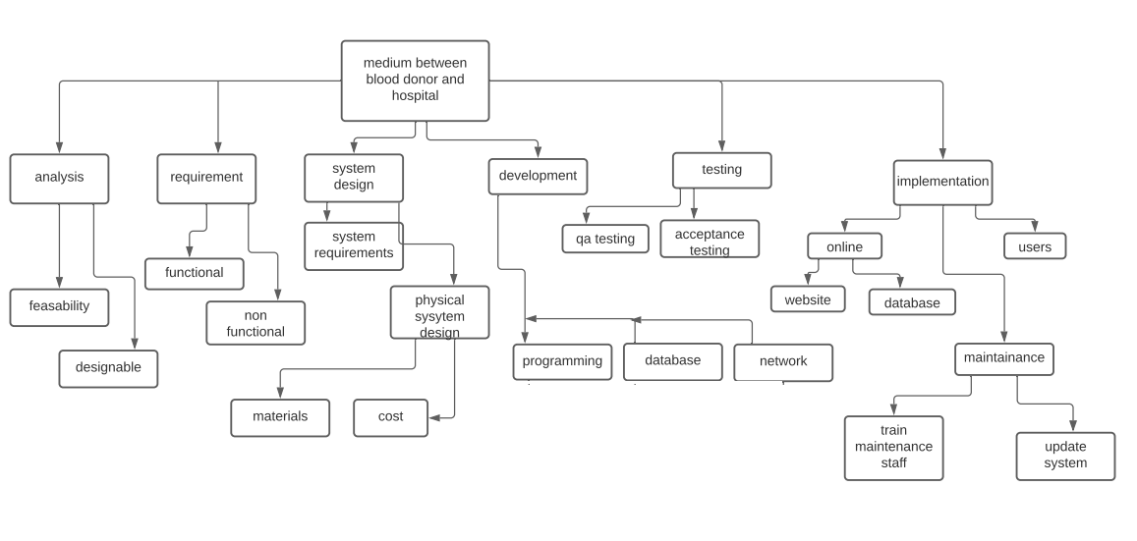
PROJECT EFFORT BASED ON RESOURCE WORK BREAKDOWN STRUCTURE: The work breakdown structure of the project is given below:

Slide 21
RISK ANALYSIS:
Customer privacy and data
Donor details will not be shared to hospital and blood bank managements for security issues. Instead of sharing patient details, the name of the hospital will be displayed to the donor.
Criteria to donate blood
Donor must submit his medical report that he is free from transmittable diseases.His age must be between 18-65 years.
He should have a minimum of 12.5 g/dL hemoglobin level and the pulse rate must be between 50 and 100.
Fraudulent Hospitals
Hospitals and blood banks must be verified by health department of the city else they may misuse the blood donated.Every Hospital and blood banks in the list will be verified.

Slide 22
Travelling problems
During rush hours , donor faces traffic tie-up so it may take time to reach the hospitals.
Crime:
Selling or donating blood in exchange for money is illegal under the National Blood Transfusion Services Act 2007.Some hospitals are doing these fradulent things and they are selling the blood donated by the donors for money.
These fradulent hospitals are targeting the blood donation applications and making money.
ESTIMATION OF PROJECT MATRICES
Function Point Analysis:
Objectives of FPA:
The basic and primary purpose of the functional point analysis is
to measure and provide the software application functional size to the client, customer, and the stakeholder on their request.

Slide 23
Types of FP Attributes
1.Number of External Inputs(EI) -Input screen and tables.
2. Number of External Output (EO) -Output screens and reports.
3. Number of external inquiries (EQ) -Prompts and interrupts.
4. Number of internal files (ILF) -Databases and directories.
5. Number of external interfaces (EIF)- Shared databases and shared routines.
COCOMO Model:
1.E = ab(KLOC)^bb
2.D = cb(E)^b
3.P = E / D
Where E refers to the effort,D refers to the deployment time ,P refers to the productivity and ab,bb,cb,db are called as coefficients.

Slide 24
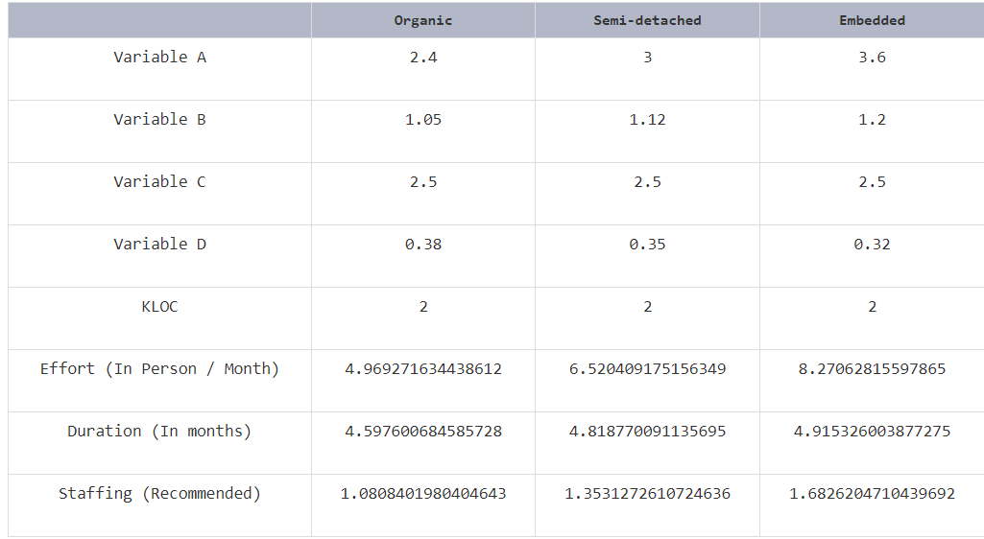
DESIGN
SYSTEM DESIGN:
Here we have used the basic software front end design model in order to
represent the system architecture of our software model.

Slide 25
Medium between Hospital and a donor
The above is a simple form of system design diagram which uses front end design. This shows a loop of functions that need to be executed when this project is implemented. This is a chain of operations through which this project is
implemented.
LOGIN
Display alert message
Details of the hospital
Location of the hospital
LOGOUT

Slide 26
MODELING USE CASE DIAGRAM AND SCENARIOS
Use Case Diagram description
Here there are three actors:
Admin
Donor
Hospital and Blood banks
The login use case has the relation with both the donor and the admin
The alert message use case has the relation with both the admin , hospitals and blood banks
Data base use case will be maintained by the admin
The alert message use case will be received to donor
The list of the hospitals use case will be maintained by admin
The details of the hospital and type of blood required use case is related to both admin and donor
GPS of the hospital use case is related to admin ,donor and the hospitals and blood banks

Slide 27
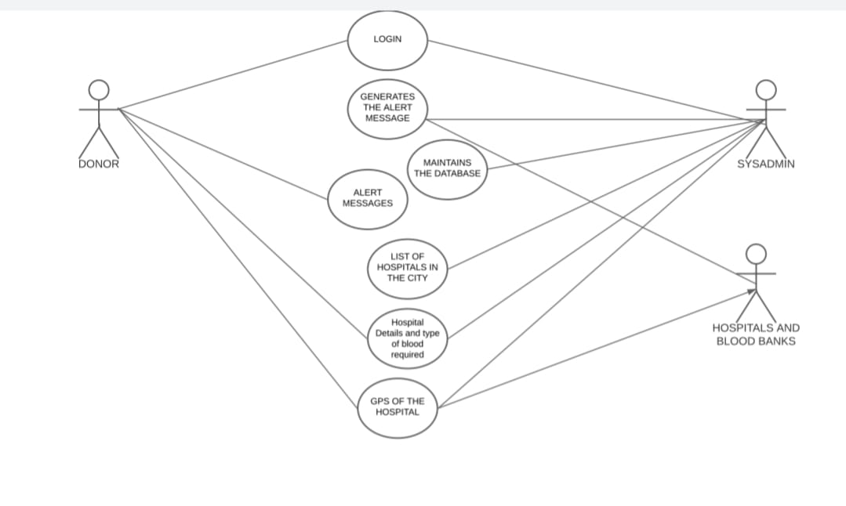
USE CASE DIAGRAM:

Slide 28
ER MODELING FROM THE PROBLEM STATEMENT
ER DIAGRAM DESCRIPTION:
An entity-relationship model decribe’s interrelated things of interest in a specify domain of knowledge. A basic ER model is composed of entity types and specifies relationships that can exist between entities.
The details of the product are stored in the product tables
Each entity has a primary key and unique keys
The entity set presented here are
Donor , blood , stock , patient
All the entities like donor , type of blood , quantity of blood are normalized and reduce duplicacy of records.
There is one to one relationship between donor and hospital/blood bank.
The issue is raised when the amount of blood in the blood bank is out of stock.
Then the request will be sent to the donors for specific type of blood groups,then the donor with similar type of blood group responds and donate to the patient.

Slide 29
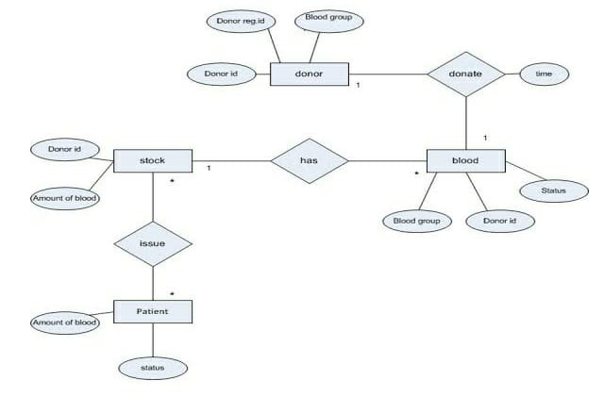
ER DIAGRAM:

Slide 30
IDENTIFYING DOMAIN CLASSES FROM THE PROBLEM
DOMAIN CLASS:
Seeker
-seeker _ id : int
-name : string
-age : int
-city : string
-blood group : string
-phone no : string
-gender : string
-registration date: string
+Registration()
+search()
+make request()
+online chat()
Donor
-donor _ id : int
-donor _ name : string
-blood group : string
-contact _ no : string
-location : string
-donor _ city: string
+registration()
+search request()
+withdraw details()
+online chat()
Blood bank
-blood bank _ id : int
-name : string
-address : string
-phone _ no : string
-website : string
-email : string
-location : string
-city : string
-blood _ stock : string
+request blood()
+purchase blood ()
+maintain stock()
Hospital
-hospital _id : int
-name : char
-address :char
-phone_no: string
-location :string
-city : string
HOSPITAL
+request Blood()
+purchase blood()
Blood stock
-id : int
-blood bank _ name : string
-bag _ no : string
-source : string
-blood group ; string
-blood _ type : string
-quantity : string
-haemolysis : string
-comment : string
+blood stock maintainability()
+view to users()
Request
-request _ id : int
-request _ data : string
-member _ type : string
-blood group : string
-quantity : string
-request _ location: string
-request _ contact : string
-member-name : string
Chat
-chat _ id : int
-sender _ id : int
-receiver _ id : int
-message : string
-date/time : string
+donor chat()
+seeker chat()
Result
+Visible to everyone()
+Represents blood()

Slide 31
DOMAIN CLASS DESCRIPTION:
General description:
A domain class is a class from the Domain model that Martin Fowler describes as follow in patterns of enterprises application architecture: An object model of the domain that incorporates both behavior and data . It is based on attributes and stereotypes , etc.
Identifying Stereotypes:
Typical domain class stereotypes include:
<<thing>>=an entity that has mass and volume
<<event>>=an entity that has a start time and duration
<<role>>=an entity that has executes tasks . For example:
<<type>>=an entity that describes other entities
Identifying Attributes
A class contains definitions of all the attributes its instance will contain.
An attribute has four attributes:
Name
Type
Visibility(+|~|#|-)
Initial value (optional)
The type of an attribute usually is not a domain class.These kinds of properties will be represented by associations.
Attributes types include:
Primitive types: int,char,string
Foundation classes:Time,date,string
External/imported classes(i.e .,classes from external domains)

Slide 32
STATECHART AND ACTIVITY MODELING
STATECHART DIAGRAM:
Start
No Reg?
Yes
No
Valid?
Yes
End
Registration
Login
View alert
View the hospital details
GPS of the hospital details
Manage the alert
Logout

Slide 33
STATECHART DESCRIPTION:
States chart diagram describes the behaviour of a single object in response to a series of events in a system.
In this diagram the states and their description are as follows:
States: A state diagram shows the behaviour of classes in response to external stimuli
Registration: This state helps to register for the new customer
Login: This state helps the customer to login into the bloodbank management system
View alert: This state gives alert message to the donor
View the hospital details: This state helps the donor to find the full details of the hospital
GPS of the hospital: This state helps the Donor to find the exact location of the hospital
Manage the alert: The alert will be deleted when the need is fulfilled
Hence the above are the states and how they work.
Transitions:
Here the transitions are the ways through which the control jumps form one state to another. Here the transitions are based on choice and requests.

Slide 34
COMMUNICATION DIAGRAM:
3:generate alerts
4:Navigate to the hospital location
COMMUNICATION DIAGRAM DESCRIPTION:
User logs into the application
User views the generated alerts
Hospital generates the alerts and it will be sent to the users
User clicks on the alert
It navigates the user towards the hospital details page
If the user needs the location of the hospital it will be provided
User goes to the hospital and donate the blood
User
1:Login
2:View alerts 5:logout
Application
Hospital

Slide 35
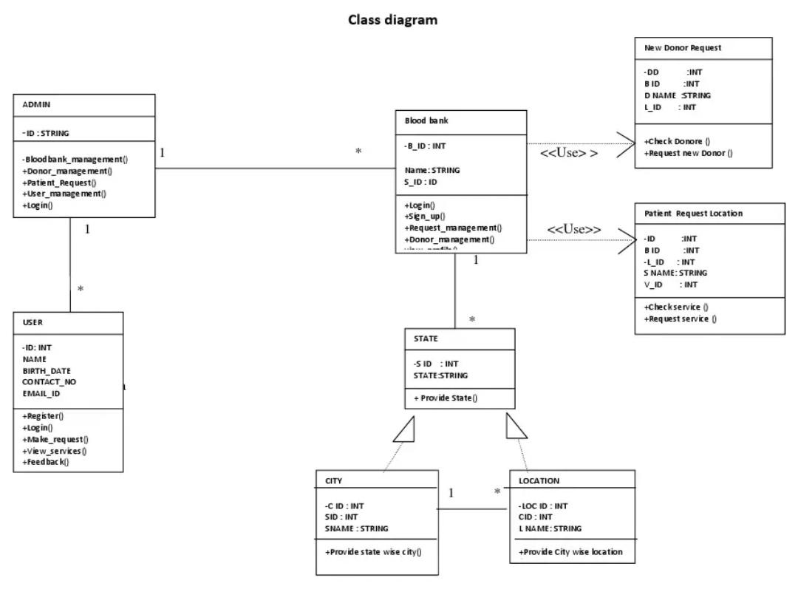
MODELLING UML CLASS DIAGRAM AND SEQUENCE DIAGRAM:

Slide 36
CLASS DIAGRAM DESCRIPTION:
A UML class diagram is a type of static structure diagram that is used both for general conceptual modelling of the systematics of the application and for detailed modelling translating the model into programming code
User registration:This class is used for the registration of the user.
Blood bank in the class diagram will request the patient location and accepts the new donor request
State in the class diagram will request the city and location of the donor
The most important relationship in the class diagram is the relationship between the bloodbank class and state class because it has multiplicity relationship.

Slide 37
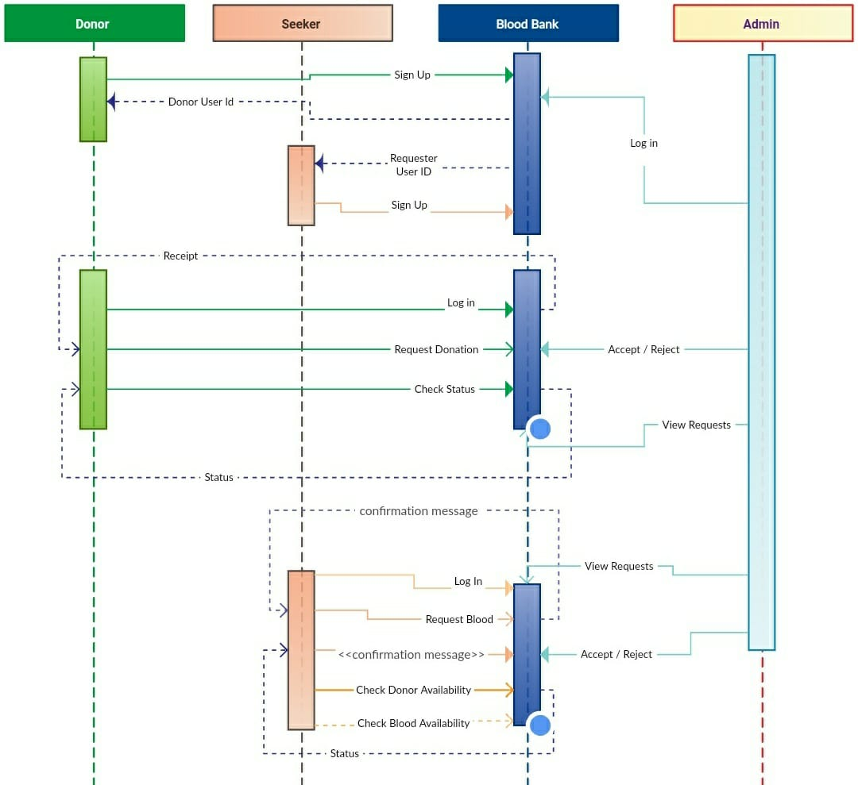
SEQUENCE DIAGRAM:

Slide 38
SEQUENCE DIAGRAM DESCRIPTION:
There are four objects:
Donor
Seeker
Blood bank
Admin
Donor sends a login request to the bloodbank,logs successfully
Seeker sends a login request to the bloodbank,logs successfully
Admin will log in to the bloodbank to see the requests
Blood bank will send request for the donation of blood to the donor
Seeker will request the bloodbank
Bloodbank will check the donor availability and blood availability
Admin will see the availability and he will decide whether to accept or reject the request

Slide 39
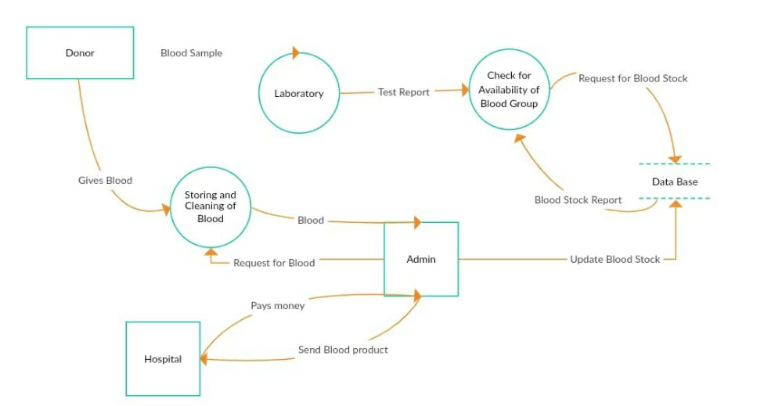
MODELLING DATAFLOW DIAGRAM:
Dataflow diagram:

Slide 40
DATAFLOW DIAGRAM DESCRIPTION:
A dataflow diagram is a view of how data is processed in a system in terms of input and output.
The flow of the data in which the update of blood stock, request for blood and blood stock report which is done through data base is shown in figure
It contains all of the userflow entities such as bloodstock , request of blood , donor,
It begins with the login system in which the data flow is between the donor database and other verification modules like request and update of blood
As it begins with the login system by the donor,it generates the details of the blood stock and request the blood which is in need
The flow of the other entities is shown in the above diagram

Slide 41
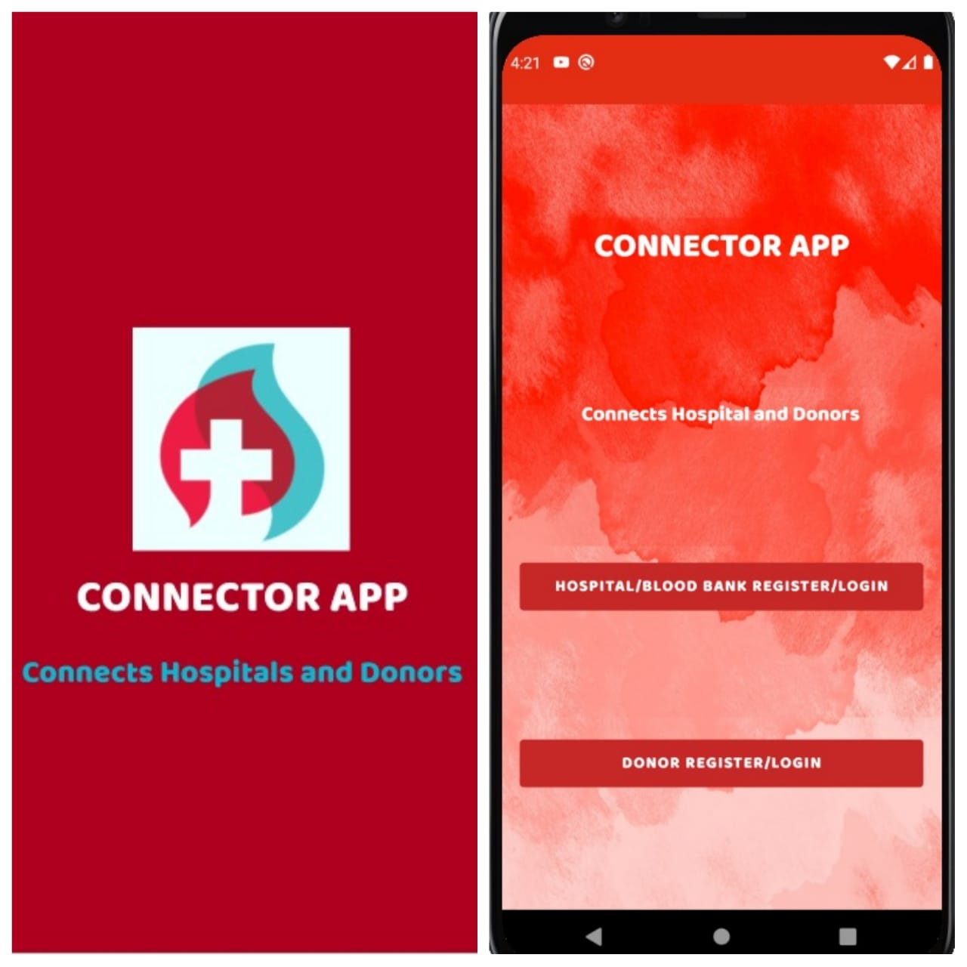
IMPLEMENTATION
DESIGNER VIEW:

Slide 42
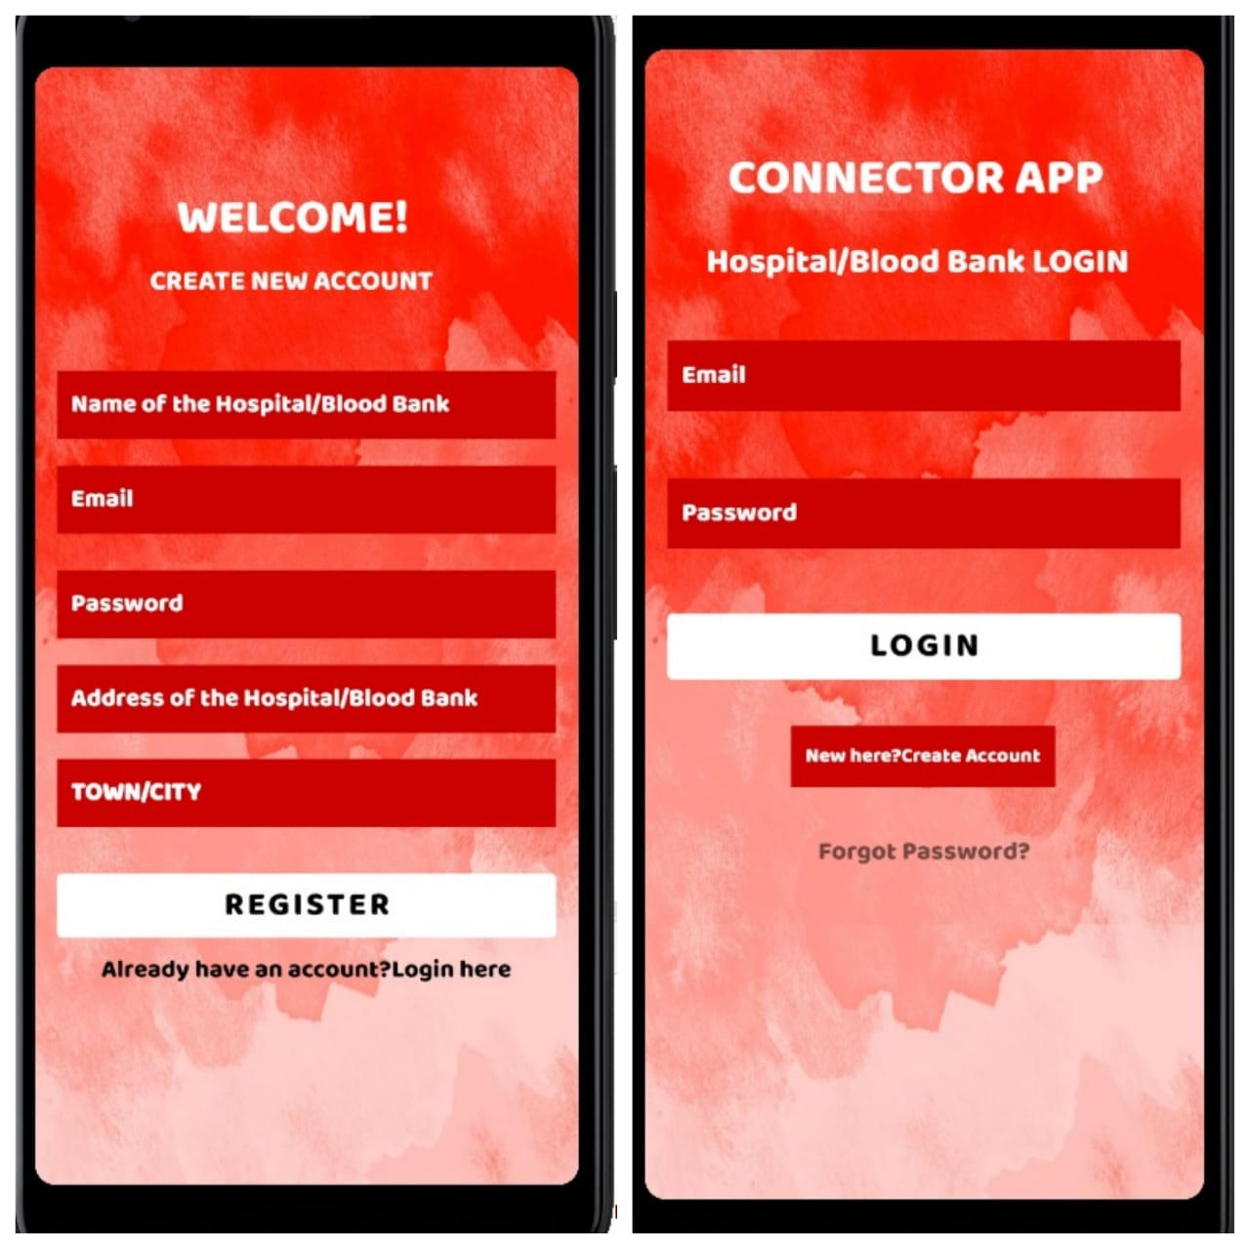

Slide 43
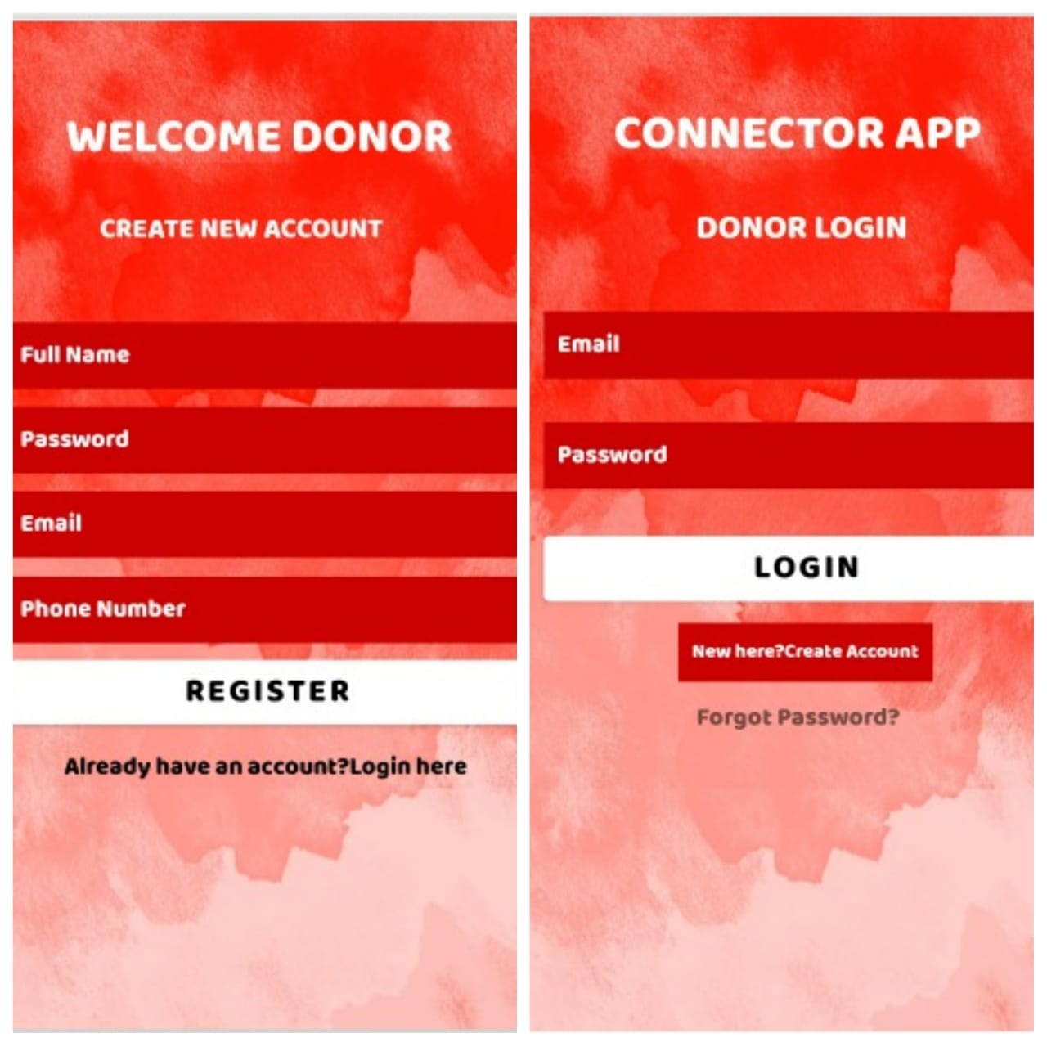

Slide 44
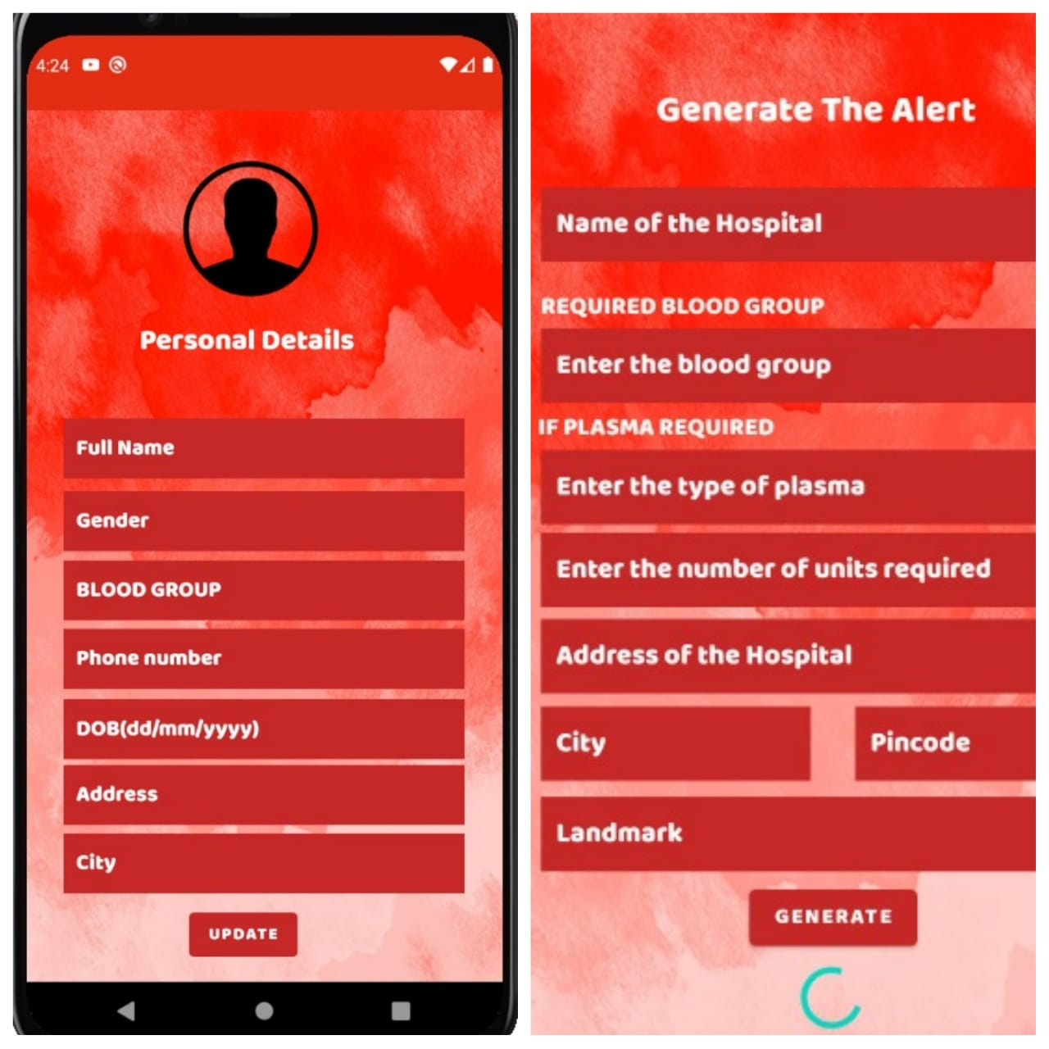

Slide 45
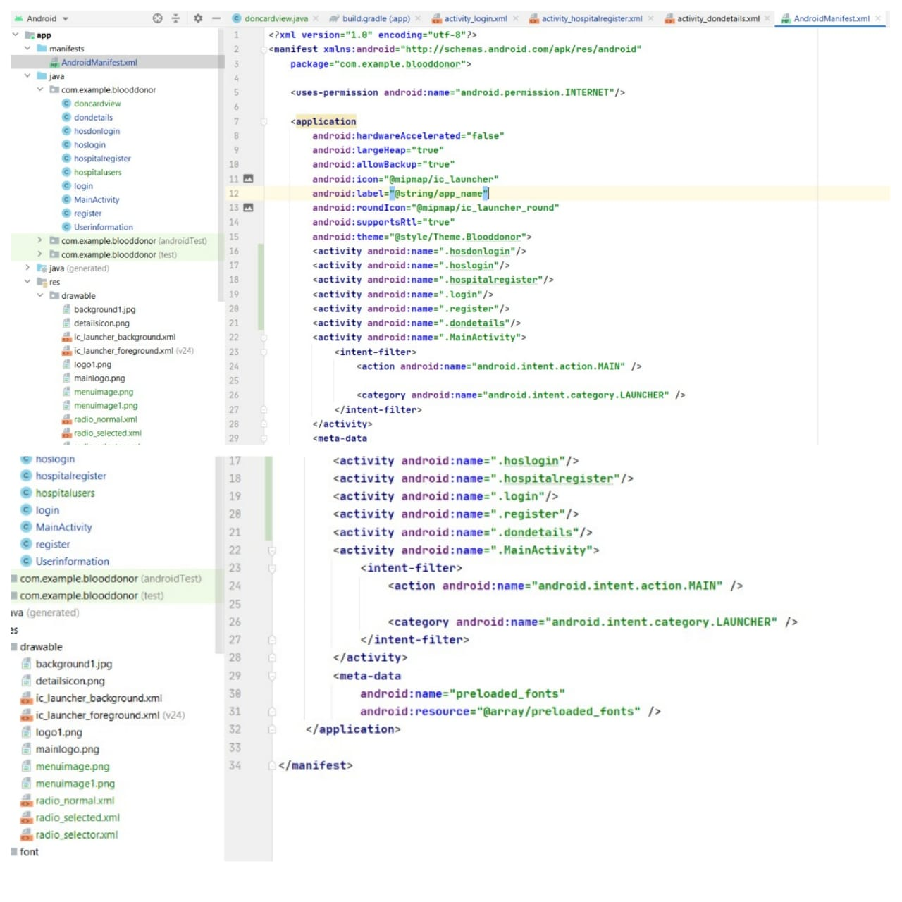
CODES VIEW:

Slide 46
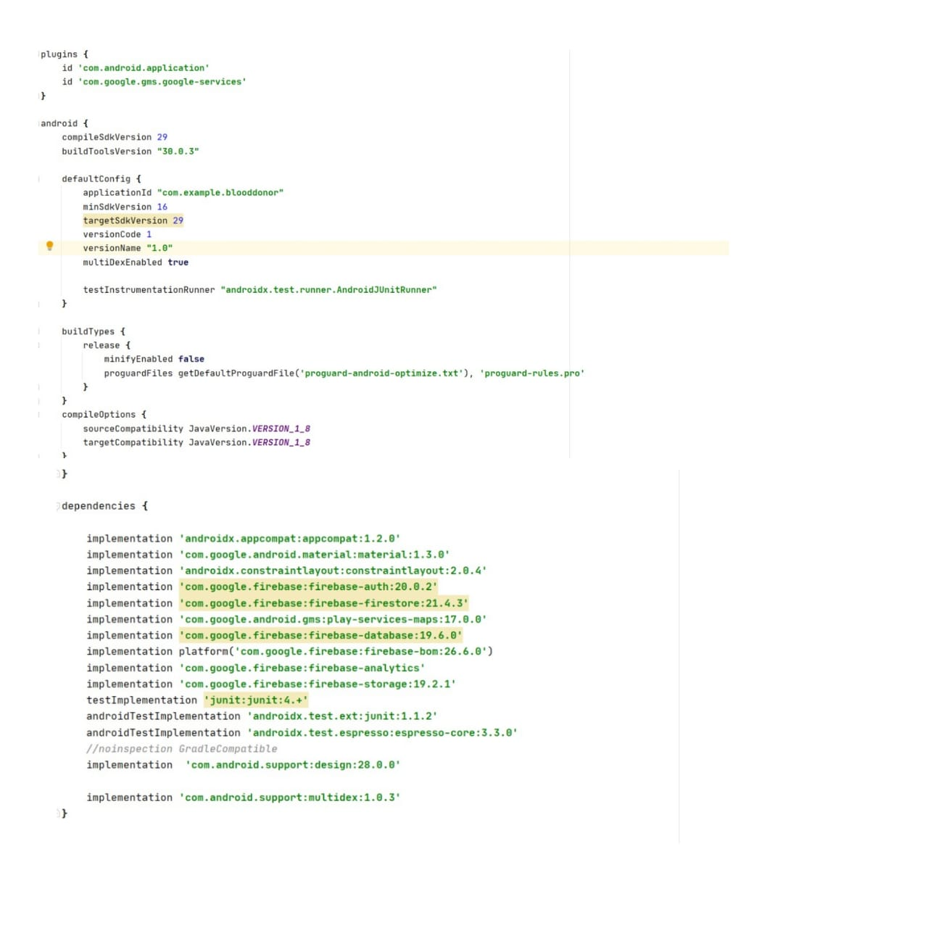

Slide 47
Estimation of Test Coverage Metrics and Structural Complexity
15.1 CONTROL FLOW GRAPH
LOGIN
DONOR
HOSPITAL AND BLOOD BANKS
TRUE
FALSE
TRUE
FALSE
ALERT PAGE
REGISTER PAGE
GENERATE ALERT
REGISTER PAGE
VIEW
ALERTS
SEND ALERTS TO DONORS
LOGOUT

Slide 48
15.1.2 McCabe cyclomatic complexity
Cyclomatic complexity is a software metric used to measure the complexity of a program. It is a quantitative measure of independent paths in the source code of the program. Independent path is defined as a path that has at least one edge which has not been traversed before in any other paths. Cyclomatic complexity can be calculated with respect to functions, modules, methods or classes within a program. This metric was developed by Thomas J. McCabe in 1976 and it is based on a control flow representation of the program. Control flow depicts a program as
a graph which consists of Nodes and Edges.
Mathematical representation:
Mathematically, it is set of independent paths through the graph diagram. The
Code complexity of the program can be defined using the formula –
V(G) = E – N + 2
Where,
E - Number of edges
N - Number of Nodes
V(G) = P + 1 ,
Where P = Number of predicate nodes (node that contains condition).
Calculation:
E - Number of edges=12
N - Number of Nodes=10
V(G)=12-10+2=4
Complexity =4

Slide 49
15.1.3 Optimum value of cyclomatic complexity
Cyclomatic complexity is used to gauge the overall intricacy of an application or specific functionality within it. The software metric quantitatively measures a program's logical strength based on existing decision paths in the source code.
Complexity (M) = Edges (E) – Nodes (N) + Exit Nodes (P)
Complexity(M)=12-10+1=3;
Hence It is a Simple Module with low risk level.
16.1 DESIGN TESTING SUITES
16.1.1 SOFTWARE TESTING
Software testing is the process of evaluation a software item to detect differences between given input and expected output. Also to assess the feature of A software item. Testing assesses the quality of the product. Software testing is a process that should be done during the
development process. In other words software testing is a verification
and validation process.
16.1.2 TESTING FRAMEWORKS
1.Module based testing framework:
In the modular testing framework, testers create test scripts on module wise by breaking down the complete application under test into smaller, independent tests. In simple words, testers divide the application into multiple modules and create test scripts individually. These individual test scripts can be combined to make larger test scripts by using a master script to achieve the required scenarios.

Slide 50
2.Keyword driven testing framework:
In Keyword-driven testing, we use a table format to define keywords or action words for each function or method that we would execute. It performs automation test scripts based on the keywords specified in the excel sheet. By using this Framework, testers can work with keywords to develop any test automation script, testers with less programming knowledge would also be able to work on the test scripts.
16.1.3 MASTER TEST PLAN
TESTING OBJECTIVE | FOCUSING ON PERFORMANCE ISSUE
Test Items | Register,Login,Alert Generation,Receiving a notification
Features to be Tested | Login verification,Generating alerts
Features not to be Tested | Firebase connectivity
Approach | Manual testing
Required Hardware/Software | Android 4.0 mobile, internet connectivity
Risks | Alert management
Testers & Schedule | Sumanth,April 1st 2021
Estimate | -

Slide 51
16.1.4 MANUAL TESTING
TEST AREA | INPUT | TEST DESCRIPTION | RESULT
Login Module | Login username and password | Permits the user to enter into the application | tested
Personal Info Module | User details(Name,phone number,Blood group,etc.) | Saves the registered user details to firebase | tested
Alert Management | Hospital/Blood Bank generates an alert | sends the alert to donors | tested
17.1 DEPLOYMENT REPORT
Hospital Name:DBR and SK Hospital
User logs into the application
Fill the alert generation form
Click on the generate button
Alert contains the following :
Name of the Hospital
Type of Blood Group Required
Unit Count
Address of the Hospital
City, Pincode, Landmark

Slide 52
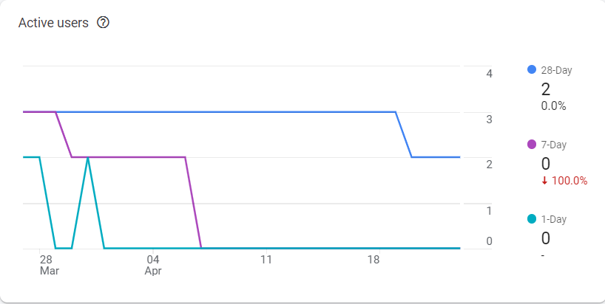
User(Donor) mail:mp2715@srmist.edu.in
Donor(user) logs into the application using email
He/She fills the their personal details
It navigates to the alert view page
Clicking on each alert ,it gives GPS location to the hospital
By viewing the alert , donor goes to the hospital and donate the blood.In this way ,instead of using Social media we can help a patient within short time.This even helps hospitals and other blood banks to get particular type of blood groups in an emergency situation.
On an average social media takes 30 mins to get a donor but using this application within 15 mins we can find a donor.Therefore this application reduces the time to found a donor.
Application user analysis report:

Slide 53
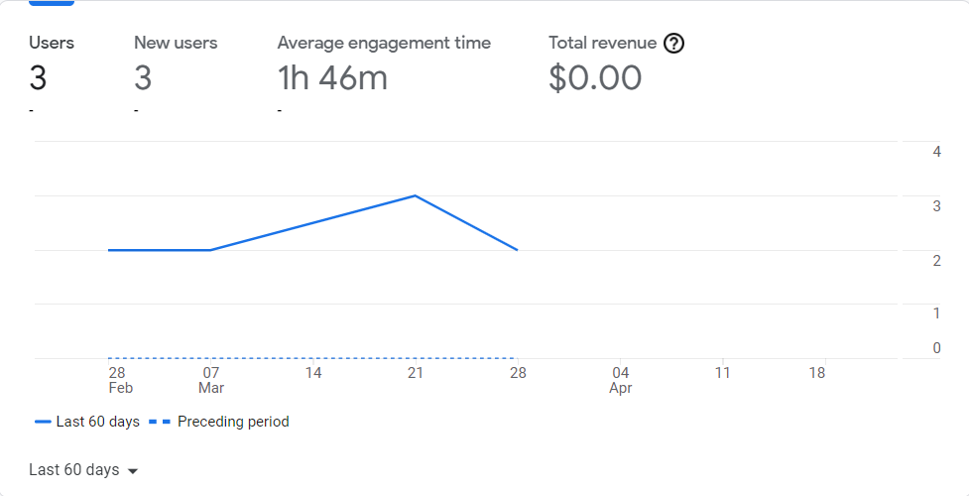
18.1 CONCLUSION
Therefore the connector app has been constructed for connecting hospitals and donors.
Benefits:
Quick response from blood donors than social media.
Hospitals\Blood banks can get blood in an emergency situation in very less time.
It helps you find places to donate.

Slide 54
19.1 REFERENCES
Java Programming for Android Developers For Dummies
https://www.google.com
https://developer.android.com/studio/known-issues
https://stackoverflow.com
https://www.simplyblood.com
https://developer.android.com/studio
Learn Android Studio: Build Android Apps Quickly and Effectively
https://en.wikipedia.org/wiki/Blood_donation_in_India
Google Maps

